Slide 1
Watson Solution Patterns Overview Expertise Finder
Business problem
Watson value proposition
Sample demo
Key client discussion points
Qualifying the client
Elevator pitch
Solution Architecture and Bill of Materials

Slide 2


We have the ability to leverage Watson to identify individuals with the right expertise to perform specific work
It’s extremely time consuming to align relevant personnel and expertise to projects and tasks. This leads to under-utilization of resources, delivery challenges, cost overruns and missed opportunities for sales. Expertise Finder will enable firms to match the job/role description with relevant employee skills and availability.
Major applicable industries
Law
Consulting
Engineering organizations
Financial services
Research & Development
Notes:
Better leverage resources to find- reducing billable time for lawyers for law firms and finding appropraite resources
Tax/ acconunting

Slide 3
Clients can enhance the value delivered to clients by staffing the right resources and decrease time to market
Overview
Value Drivers
Benefits
Locate resources within enterprises and across geographies
Ability to compare and rank available employees to match with desired case needs
Increased transparency into firm resources, to increase success rates in locating expertise
Real time utilization reporting
Improved navigation in internal directory and/or internal document system to access the required expertise
Reduce time to find appropriate resource
Expertise Finder enables companies to efficiently locate and identify expertise across the firm or with external vendors. The firm will increase operational efficiencies and increase organizational transparency.
Cost of locating expertise
Response Rates
Practitioner utilization
New Business Generation
3

Slide 4
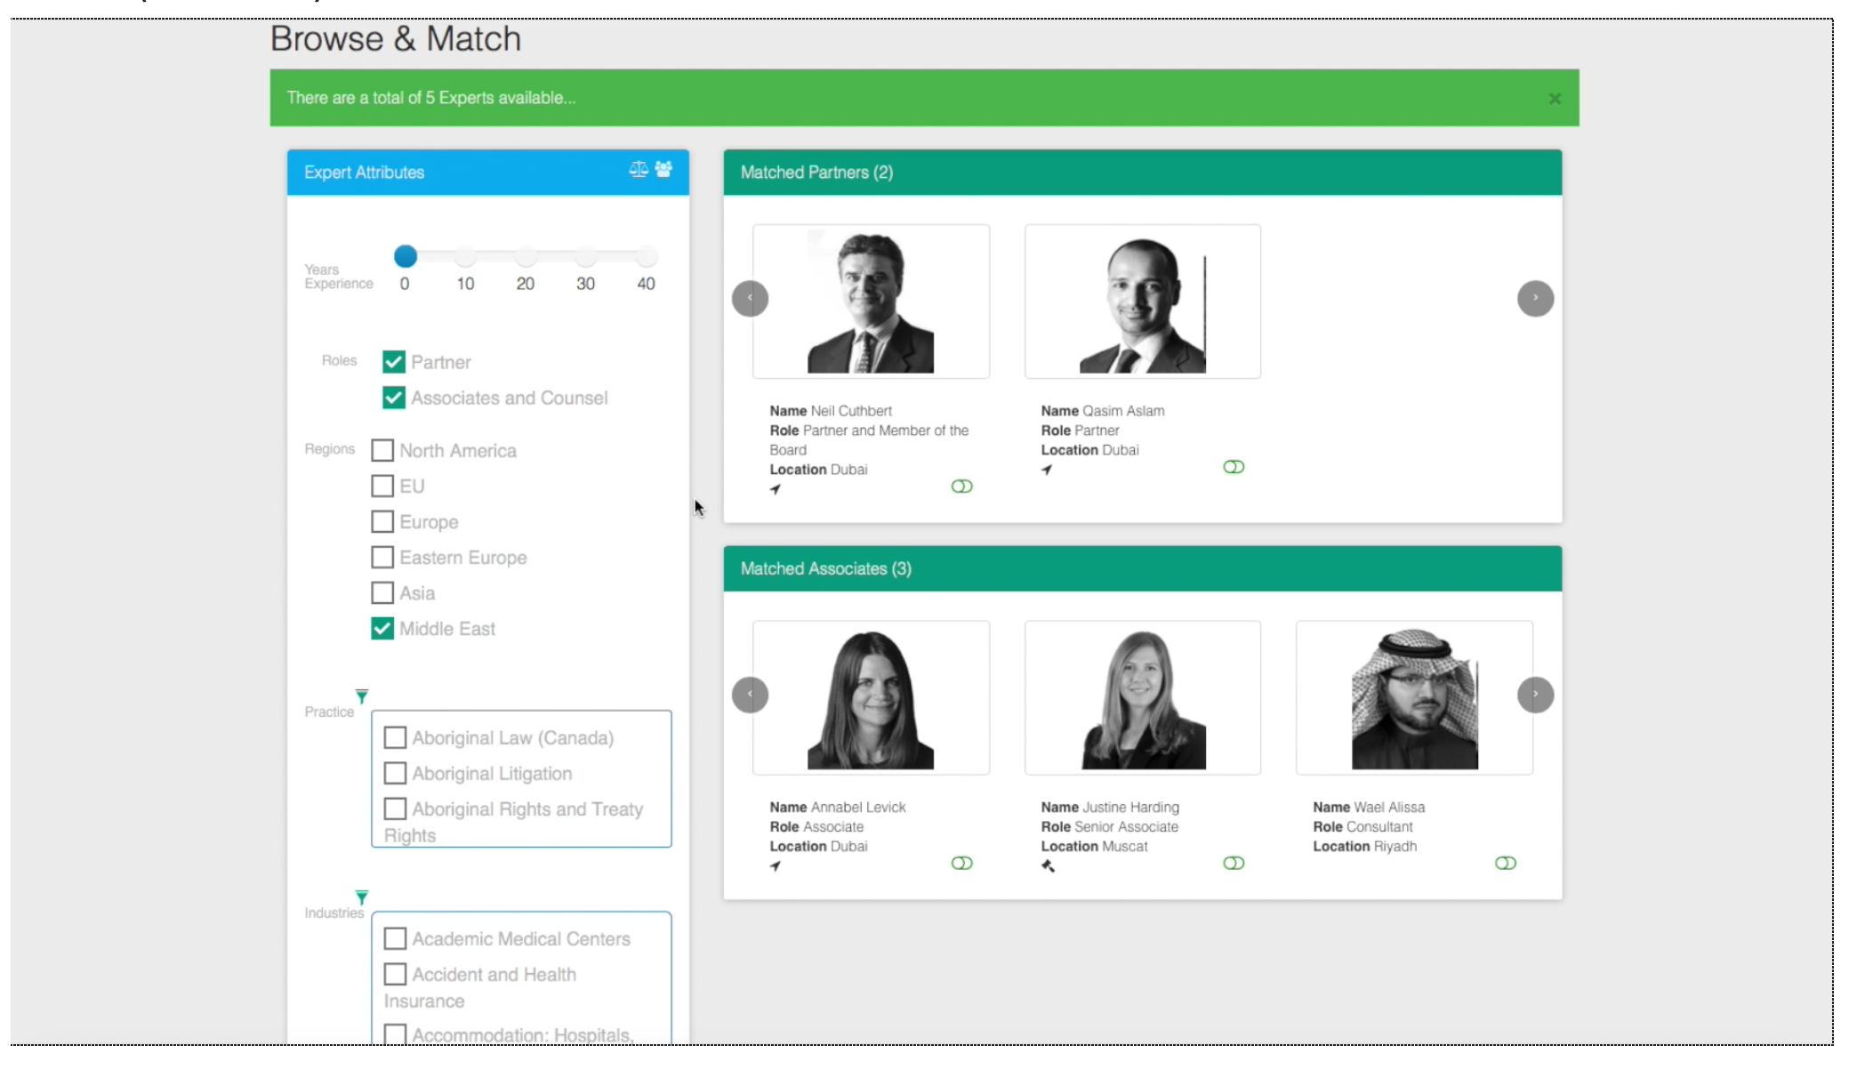
Expertise Finder Demo
Link: http://legal-expertise-finder.mybluemix.net/login
Username: watson
Password: w@ts0n

Slide 5
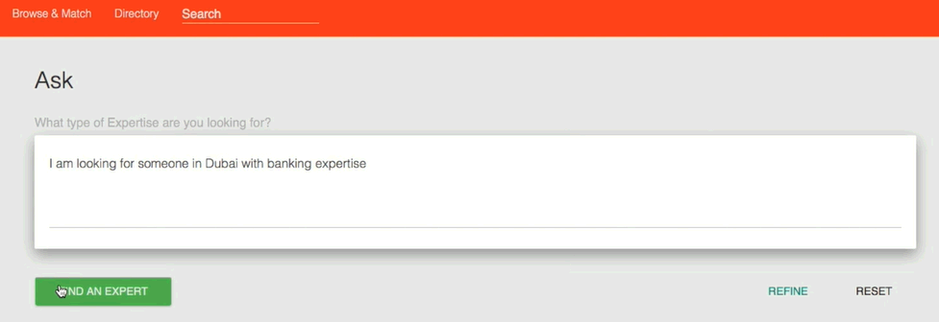

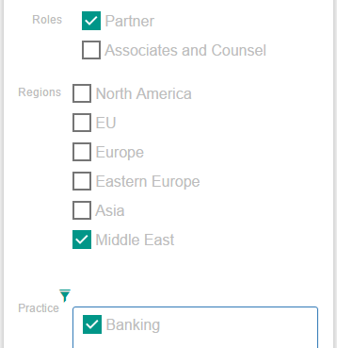
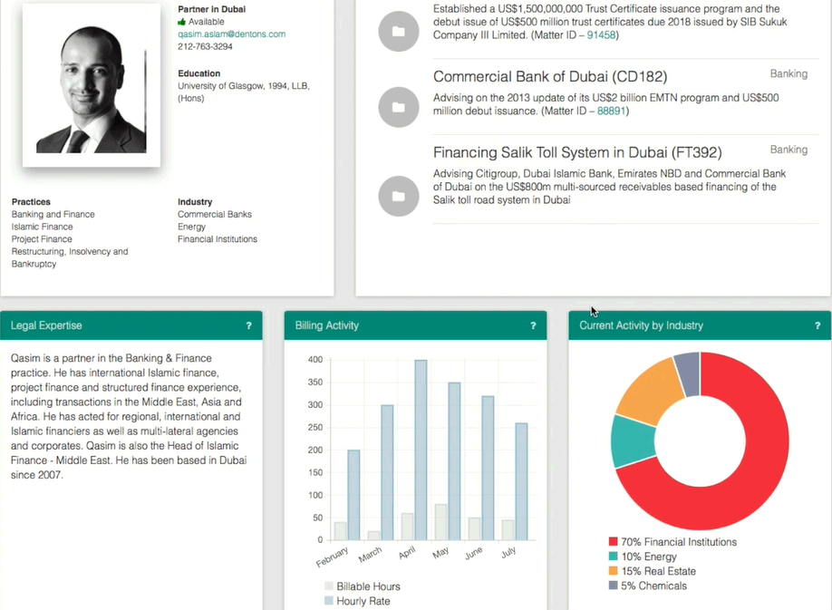
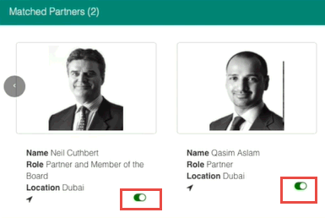
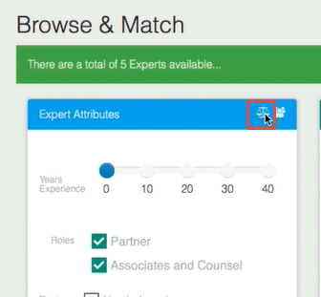
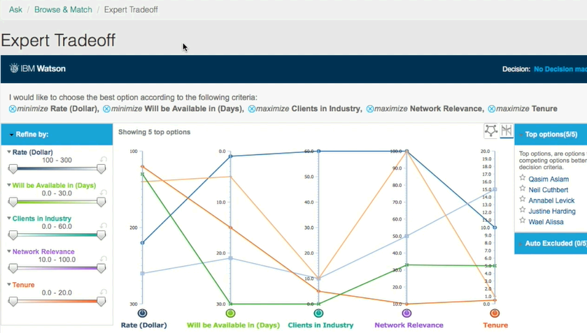
Watson Expertise Finder Script and Demo components
1. The Query
Cognitive Capabilities
In ASK field, search for “I am looking someone in Dubai with Banking experience”
Using Natural Language Processing, Watson is able to understand the context of a the clients request and develop a dictionary of custom legal annotators
2. Profile Matching
Navigate to the bottom left of the UI and filter on Industry: “Commercial Banking”
Review results by hovering over profiles and viewing their skills
Click on Quasim’s headshot to see his relevant case work, billing activity, case work percentage by industry
By auto populating attribute filters based on entity extraction of an email request, Watson will return the most relevant profile matches.
With Watson Tradeoff Analytics, Qasim and Neil
can be compared by specific criteria, most important to the case. In this scenario, we want to find someone with Islamic Finance experience, who is proficient in Arabic
3. Triangulated Expertise
Select practitioners to compare by clicking the selector toggle under their head shot
Click on Expert Tradeoff button to open Tradeoff Analytics

Slide 6
Client Qualification Checklist
Key Criteria |  | Optimal Candidates Look Like:
SPONSORSHIP: |  | Vice President and C-Level executives have the best span of control to make the decisions that drive success
VISION: |  | Understanding the impact of Watson technology and processes requires a bold vision, not an incremental one
BUDGET: |  | Being able to undertake a pilot is a great place but ensuring there is plan for broader roll-out up front drives faster adoption
CHANNEL DIVERSITY: |  | Increased channels offer a greater transformation opportunity through cognitive approaches
HUMAN CAPITAL INTENSIVE: |  | Challenged with matching resources to projects (large employee base, geographical dispersion)
SKILLS DIRECTORY: |  | Currently has a directory where practitioner skills, expertise and CVs are stored.
TIME SENSITIVITY: |  | Timing is important to the organization especially when practitioners must be staffed quickly and have availability
Notes:
Mlaw 200 firm- under 500 attorneys

Slide 7
Elevator Pitch
FAQs
What is the client buying?
Prototype of Expertise Finder
1-year Watson Explorer license and a subscription to Watson Developer Cloud that allows the client to develop and grow their own Expertise Finder
How much does it generally cost?
$250K for 1 year & 2 weeks for the client to build/deploy the existing an initial pilot
How does the solution get implemented?
There are two options:
Self-Serve: 1-week enablement session for client developers with education on the solution pattern. After which, client IT teams then develop/deploy the solution in a self-serve mode.
Vendor-implemented: Hire a systems integrator
How long does it take?
2 weeks to build a prototype
Watson can help managers better identify resources within an organization to best fit roles for projects (building teams)
Current searches for subject matter expertise is time consuming (and time sensitive) and often relies on word of mouth
This is done by understanding, at a deep level, the contextual expertise of the employees and/or contractors bring
Watson can reduce the costs associated with locating expertise and enable managers to choose the right employees for the appropriate projects

Slide 8
Start NOW. Continue with intense focus and deep passion for success.
1.
Target solutions for your accounts
Review materials
Solutions Card
Seller’s Brief
Demo + Script
Customize your messaging and materials
Prepare your pitch
Practice using the demos
2.
Determine your client customization
Determine which patterns work best
Request customized demos for solutions most relevant to industry and account (SC number needed)
Determine data and content sources
3.
Conduct your meeting with confidence
Effective, well rehearsed demos (video alternatives)
Direct, relevant slides
Ability to move quickly to sales process
And please be sure to give us your feedback!

Slide 9



Solution Architecture and Bill of Materials
Attorney
Relationship Extraction
(Identify relationships between different legal entities)
Watson Framework
WEX Advanced
WCA Studio
App Builder
WKS integrated with WEX Runtime
Watson Platform (Bluemix)
AlchemyLanguage
Tradeoff Analytics
Visual Recognition *
Other Bluemix
Cloudant
Insights for Twitter *
Expertise Finder 360º Desktop UI (Responsive App)
Entity Extraction
(identify legal entities to quickly understand the subject of the case request)
Legal Expertise Request Queue
Watson Platform API’s
Attorney Facts & Details
Expertise Case Request
Additional Services
Keyword Extraction
(Generate legal tags for further case request due diligence)
Tradeoff Analytics
(Quickly decide between related experts & expert availability)
Expert Knowledge Graph DB
(Synched from Internal & External IT Systems, Files, Lawyers.com etc.)
WEX AE API’s
Legal Annotators
(Region, Year of Experience, Role, Practices, Industry)
Case History Passage Units. Attorney Profiles etc.
Curate
Ingest, Enrich & Index
Web Server / CMS
Curation Process
Acquire / Crawl
Curate
WEX Advanced
Transform
(into well Structured + Enriched Answer Units)
Annotate
Index
Documents
WKS / WCA Studio
Dictionaries
Ontology
Multimedia
Raw Content
Corpus
Host for full retrieval
Attorney Information
Rates, Availability, Distance from Location
External Data
(Lawyers.com, FindLaw.com etc.)
News, Twitter

